Slide 1



Submitted By – Digant Gupta
DIGANT VAIBHAV GUPTA

Slide 2


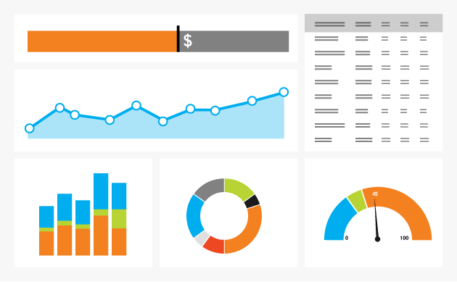
Problem Statement
The objective of this project is to build a model which will optimize the job search of the candidate .
To predict which companies have a higher chance of shortlisting the candidate for further process given the skillset of the individual and the job requirements.

Slide 3


Solution Methodology
Data Collection
Text Mining
Finding Word Associations
Word Cloud Generation
Word Associations
Topic Modelling
Interpretations
Decision Trees
Random Forests
Interpretations of the model

Slide 4

Data Collection
Job Portals
Naukri.com
Job Profile
Data Analyst
Skillset
R, SAS, Python
LinkedIn
Data Scientist
Business Analyst
Predictive Analytics
Shortlisted
Statistical Analysis
15/100
After 14 days
100 Jobs

Slide 5

Text Mining
Corpus
Load data from CSV
Text Preprocess
Lower Case
DTM
Frequency of words
Corpus : A collection of documents
Remove
Stem : Convert to root word
Load libraries TM
Sparse
Punctuations, Numbers, Stop-words
Document Term Matrix
Remove sparse terms

Slide 6
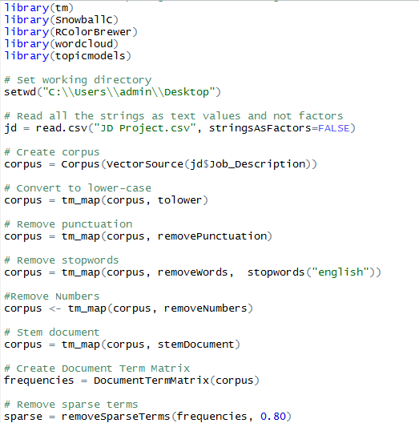


Slide 7
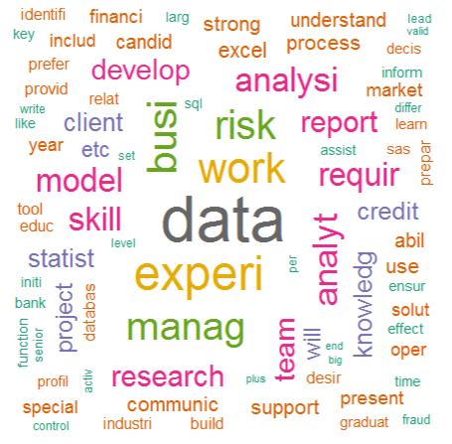
Word Cloud

Slide 8
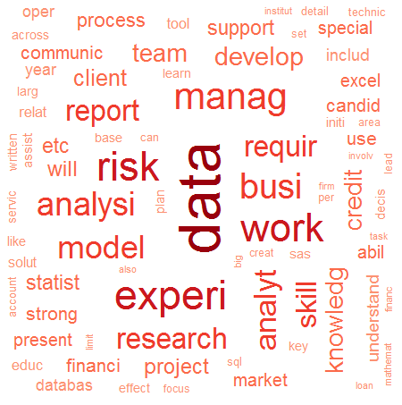
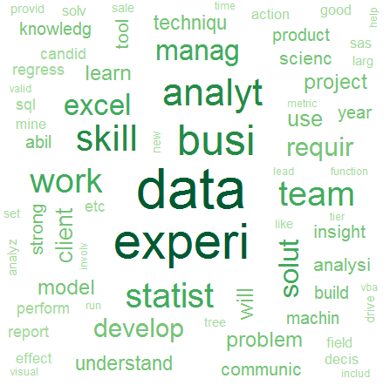
Word Cloud
Not Short listed V/S Short listed

Slide 9






Word Associations

Slide 10
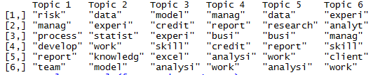
Topic Modeling
Data Scientist
Research Analyst
Risk Analyst
Credit Analyst
Business Analyst

Slide 11
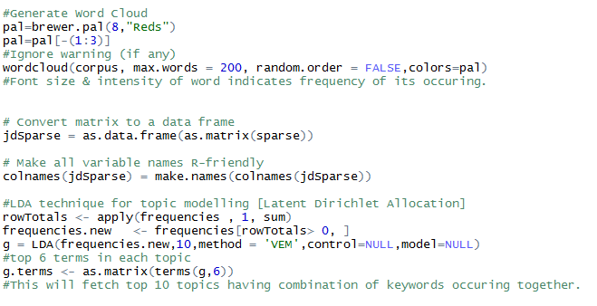

Slide 12

Interpretations
Word Cloud:
Prominent keywords for job description where CV was shortlisted are “statistics”, “statistical”, “analyst” and “business”.
Keywords for job description where CV was not shortlisted are “risk”, “report” and “research”.
Word Associations:
Words associated with “business” are “decision making”
Words associated with “statistics” are “computer” ,”technique”
Words associated with “risk” are “measure”, “align”
Words associated with “report” are “kpi”, “summary”
Topic Modelling:
Major topics extracted from the job descriptions are “data scientist”, “business analyst” , “risk analyst”, “credit analyst”, “research analyst”

Slide 13
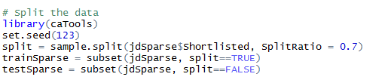

Split Data
Development Sample
70%
Validation Sample
30%

Slide 14
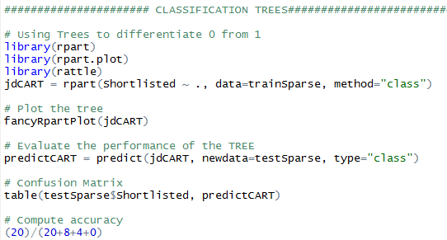
Classification Tree

Slide 15

Classification Table of Tree
Accuracy = (20)/(20+8+4) = 62.5%

Slide 16
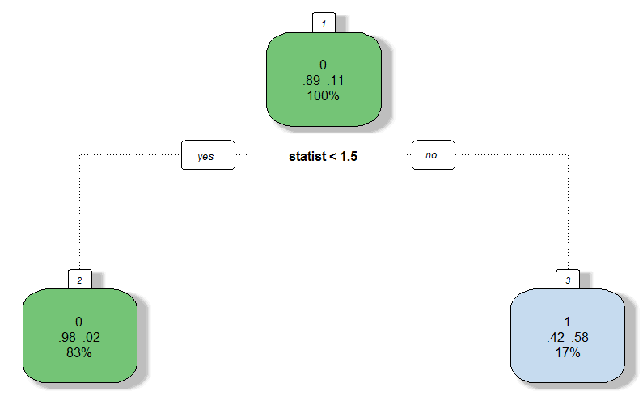
Plot Tree

Slide 17

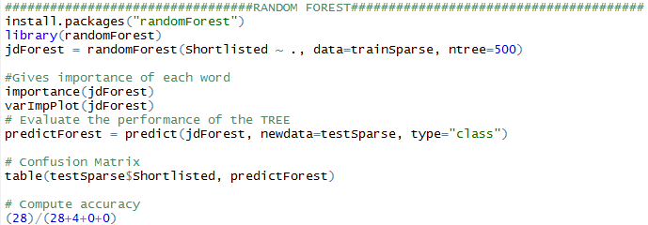
Random Forest

Slide 18

Classification Table of Random Forest
Accuracy = (28)/(28+4) = 87.5%

Slide 19
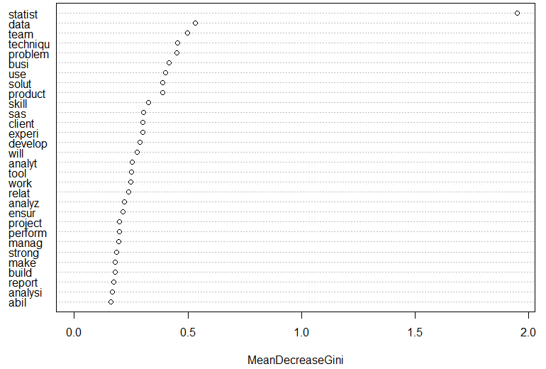
Keyword Importance Plot

Slide 20

Interpretations
Trees :
If on an average a job description contains the keyword “statistics” or “statistical” with a frequency of 1.5 or greater then there are higher chances of the CV getting shortlisted for further process.
The model is able to identify the jobs where one would not be shortlisted with an accuracy of 62%
Random Forest :
This algorithm also identifies the keyword “statistics” or “statistical” as the one which will identify the difference between shortlisted and not shortlisted.
Other important keyword are “data”, “team”, “techniques” and so on.
Random forest also predicts the jobs where one would not be shortlisted with an accuracy of 82.5%

Slide 21

Thank you
And
Have a NICE Day!!!!

